Slide 1
Amplify Planning & Forecasting with Gen AI
July 2024

Slide 2





Amplify Planning & Forecasting with Gen AI
GenAI-driven insights to support planning & forecasting
Planning Engine
Extract most accurate and relevant external market economic condition, customer trends, world affairs in form of planning factors
Provide structured inputs to determine upcoming trends and risks which can influence the forecasts with supplementary documentation
Market Indicators
Quality market insights
Realtime interface with planning and forecasting engines with capability to propose action or automatically apply mark-ups/mark-downs
Proposed actions
Relevant recommendations
Defined planning engine learning models based on past prediction vs actual data for continuous improvement in prediction accuracy.
Ask Me
Mark-ups / Mark-downs
Multi-lingual notification to approvers, requestors and data stewards
Apply external factors
Value adjustments
Automatic execution
Summarization
Propose action
Open query
Translation

Slide 3
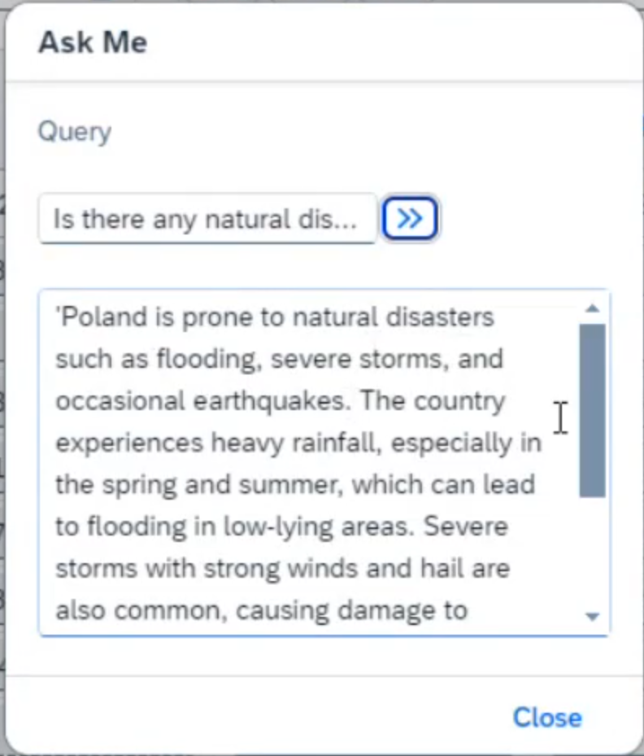
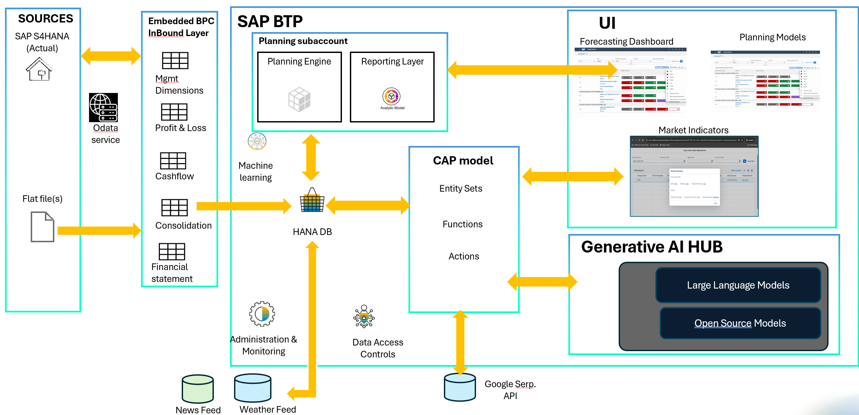
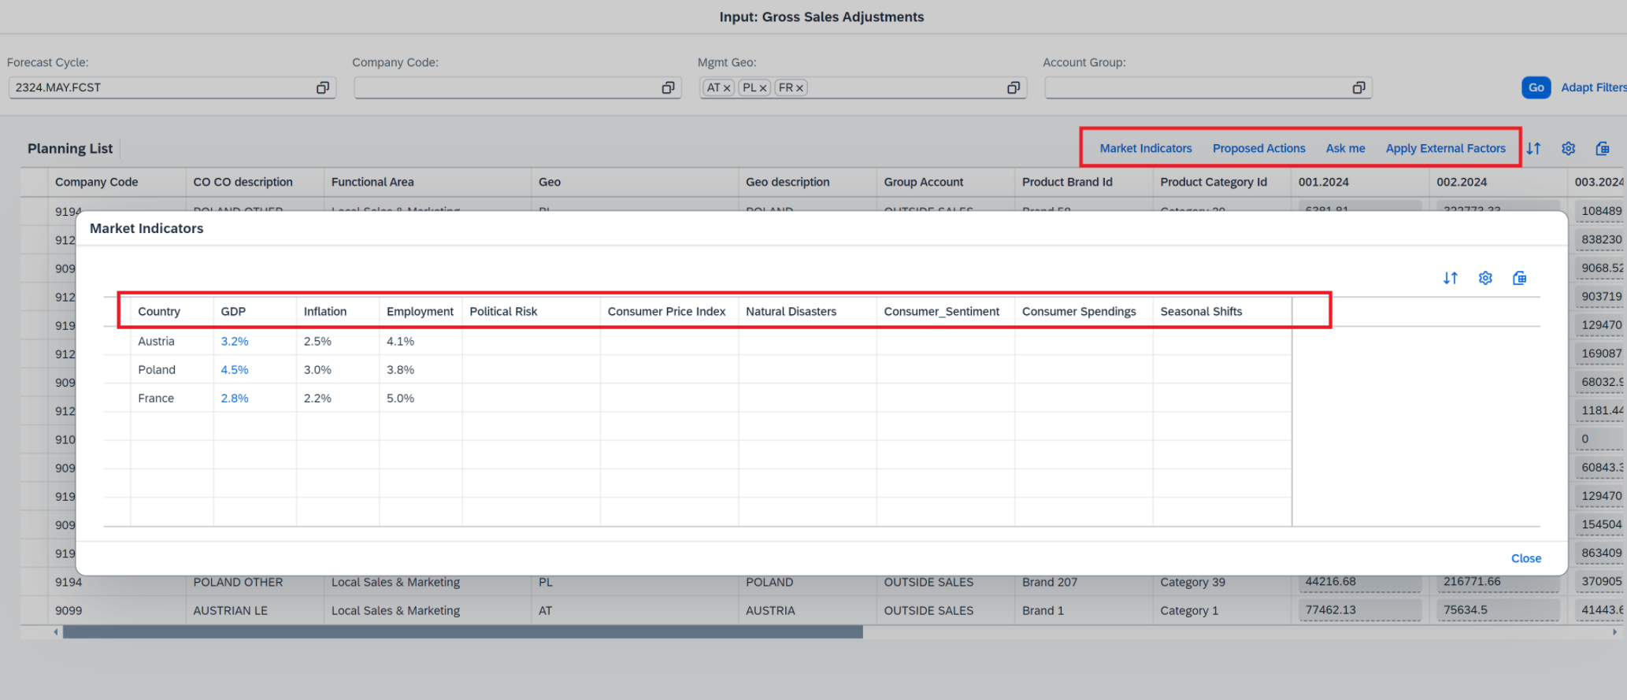
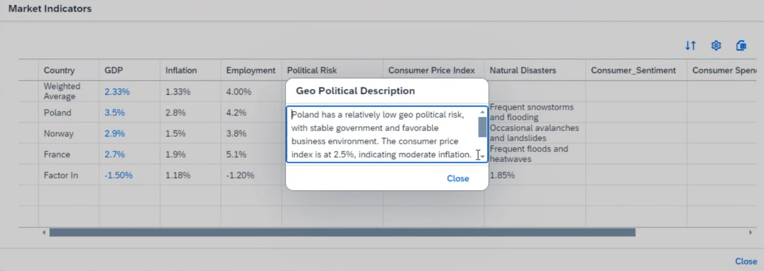
Solution Overview

Slide 4






Amplify Planning & Forecasting with Gen AI
Key challenge solved
Applicable across industries
CHALLENGE
RESULTS
Highly manual and time-consuming process
Lack of Transparency
Non- reliable external data sources
Discrete standards for determining predicted values
No supplementary documents to verify
30% Improvement in forecasting accuracy
Reliable and standardized data sources
SOLUTION
Automatic and optimized forecasting factor inputs
Extract most accurate and relevant external market information
Provide structured inputs to planning engine with supplementary documentation
Realtime interface with planning and forecasting engines with capability to propose action or automatically apply mark-ups/mark-downs
Uniformed and transparent criteria to determine forecasting factors
Early determination of risks

Slide 6

Amplify Planning & Forecasting with Gen AI
Key challenges solved
Applicable across industries
CHALLENGES
RESULTS
Highly manual and time-consuming process
Lack of Transparency
Non- reliable external data sources
Discrete standards for determining predicted values
No supplementary documents to verify
30% Improvement in forecasting accuracy
Reliable and standardized data sources
SOLUTION
Automatic and optimized forecasting factor inputs
Extract most accurate and relevant external market information
Provide structured inputs to planning engine with supplementary documentation
Realtime interface with planning and forecasting engines with capability to propose action or automatically apply mark-ups/mark-downs
Uniformed and transparent criteria to determine forecasting factors
Early determination of risks

Slide 7
Amplify Planning & Forecasting with Gen AI
GenAI-driven insights to support planning & forecasting
Planning Engine
Extract most accurate and relevant external market economic condition, customer trends, world affairs in form of planning factors
Quality market insights
Provide structured inputs to determine upcoming trends and risks which can influence the forecasts with supplementary documentation
Market Indicators
Realtime interface with planning and forecasting engines with capability to propose action or automatically apply mark-ups/mark-downs
Relevant recommendations
Proposed actions
Defined planning engine learning models based on past prediction vs actual data for continuous improvement in prediction accuracy.
Mark-ups / Mark-downs
Ask Me
Multi-lingual notification to approvers, requestors and data stewards
Value adjustments
Apply external factors
Summarization
Propose action
Open query
Automatic execution
Translation

Slide 8
Solution Overview

